Slide 1
M6 Project Work: Improve Previous Graphs and Add Additional
Group-6 (Team Sherlock’s)
Tushar Ahuja
Aswin Karthik Panneer Selvam
Nandini Reddy Basupally
Shashank Shekhar

Slide 2
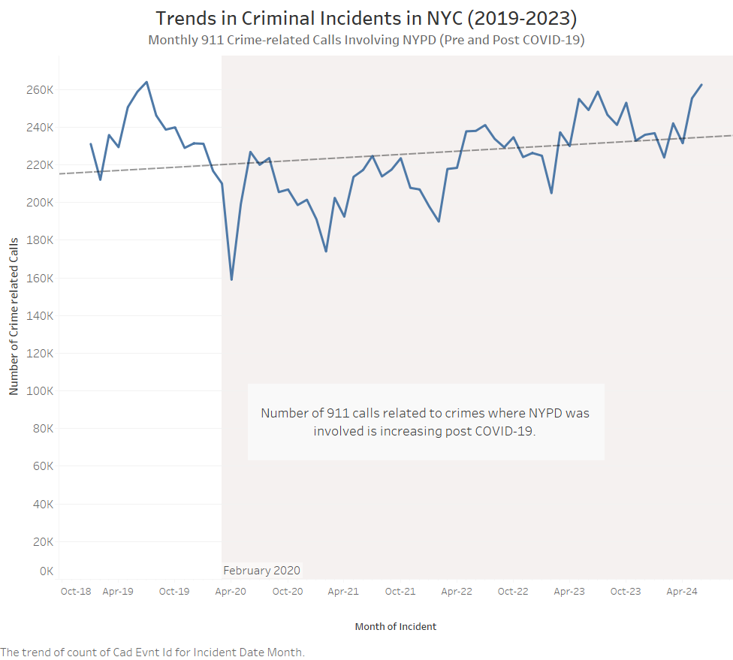
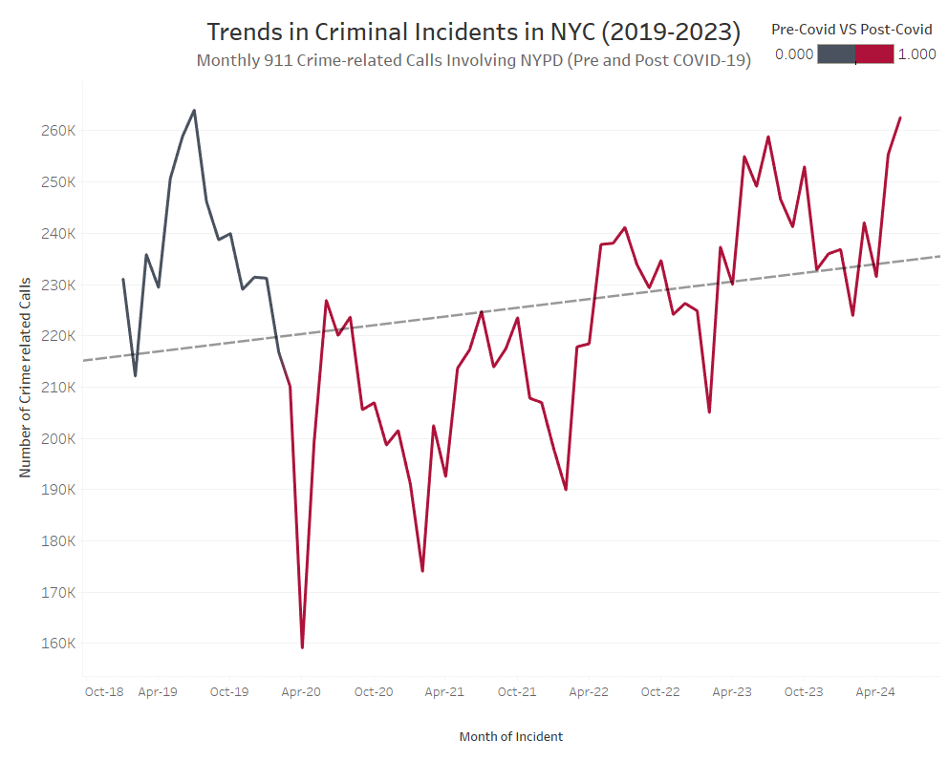
VIZ 1
OLD
NEW
Reason
The y-axis range was changed from 0 to relevant point to show the increasing trend
Color of pre and post COVID was subtly represent in the line itself (Post Feb 2020 is considered as Post-Covid)
Annotations are removed

Slide 3
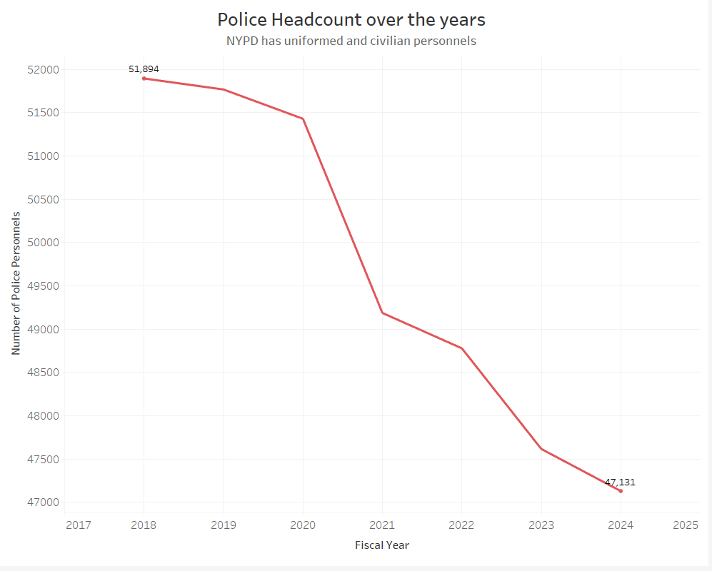
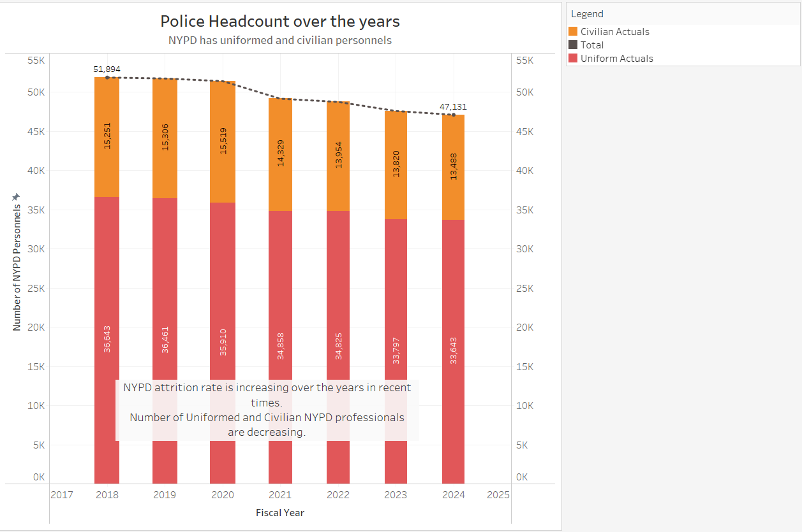
VIZ 2
OLD
NEW
Reason
Cluttered bar and line chart was converted to a simple line graph to show the steep decline in the number of police personnels from 2018 to 2024

Slide 4
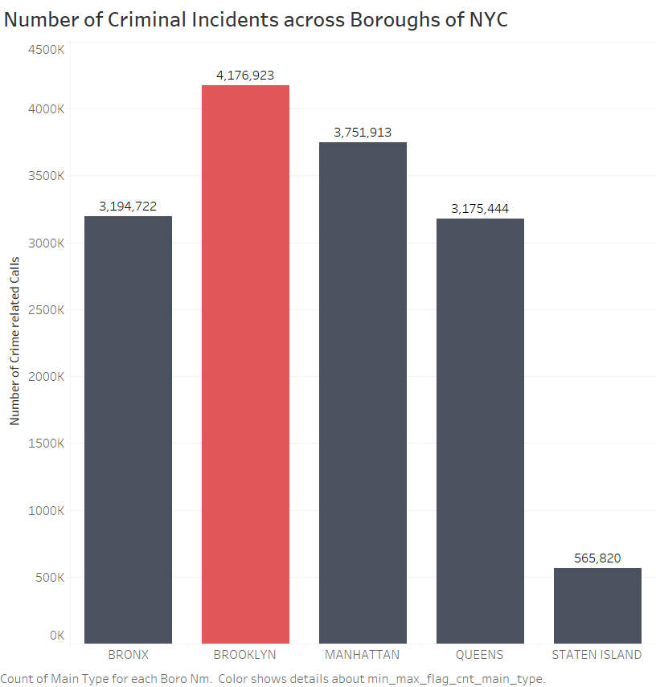
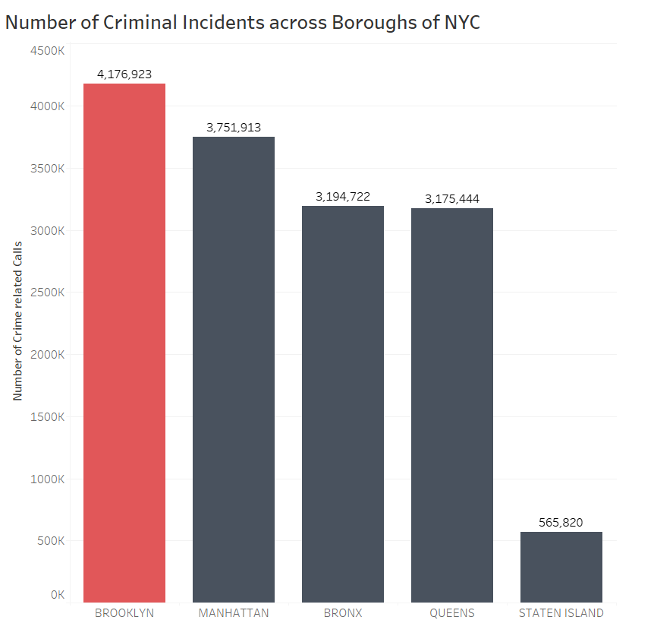
VIZ 3
OLD
NEW
Reason
The bar chart was ranked in descending order to shows the number of criminal incidents across boroughs of New York City.

Slide 5
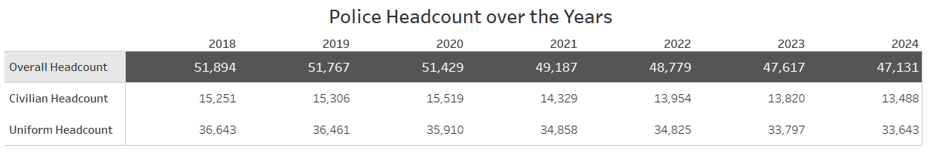
TABLE 1
Reason
No changes in table, since it’s updated from M4 to M5 and there are not feedback for M5

Slide 6
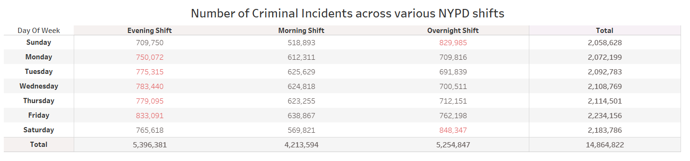
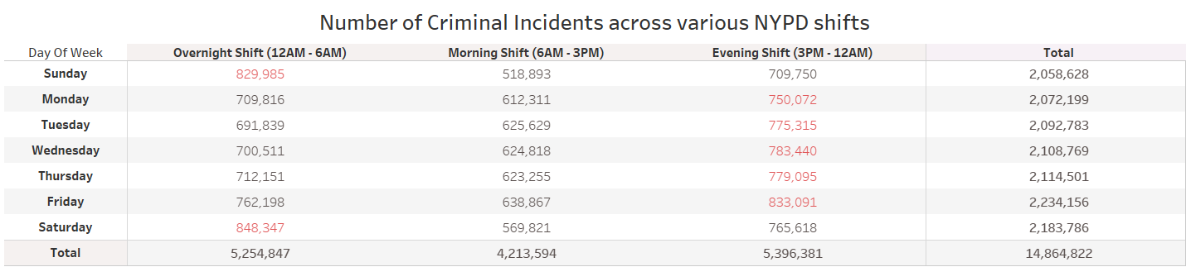
TABLE 2
OLD
NEW
Reason
The columns are order in chronological order.
Shift timings are added to the column names to improve clarity of information

Slide 7
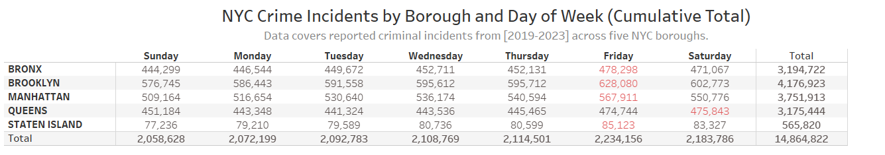
TABLE 3
Reason
No changes in table, since it’s updated from M4 to M5 and there are not feedback for M5

Slide 8
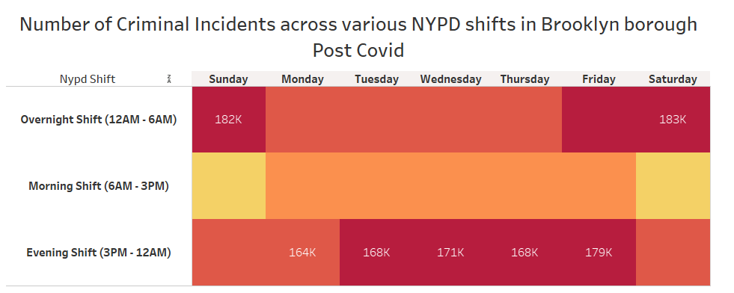
VIZ 4 - NEW ADDITION
Comments
This heatmap shows the number of crimes across NYPD shift and days of week in Brooklyn borough where the number of crimes were the highest (as shown in Viz 3)

Slide 9
New Visualizations - Individual

Slide 10
VIZ 1

Slide 11
VIZ 2

Slide 12
VIZ 3

Slide 13
TABLE 1

Slide 14
TABLE 2

Slide 15
TABLE 3

Slide 16
VIZ 4

